Slide 1





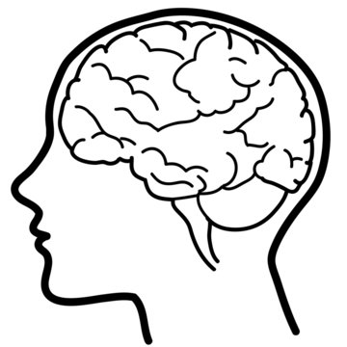
GAI (Model of Reasoning and Behavior)
ABM (Model of Spread)
Large Language Model (ChatGPT)
Personal Information
- Name, age
- Personality traits
- Resides in Dewberry Hollow
- Job status
API Calls
API Calls
Decision
Reasoning
Response
Health Information
- Feels normal
- Has a slight cough
- Has a fever
Environmental Information
- Knows about virus
- Aware of daily new cases
Agent 1
Agent 1
Agent 2
Agent N
Information Feedback

